Slide 1


TENNIS COURSE SPECIALIST IN TENNIS INDIVIDUALIZATION COACHING
MODULE 1
MOTOR LEARNING
IF YOUR PLAYERS DONT LEARN
THE WAY YOU TEACH
THEN TEACH THEM THE WAY THEY LEARN
COACH SMARTER,
COACH EASIER
COACH BETTER
TUTOR:
YVES LATREILLE
International certified tennis-fitness-mental
Coach
Certified in motor motions préférences
Sports-tennis
mytenniscloud

Slide 2
COURSE CONTENT TENNIS NATURAL MOTOR MOTION
+ COGNITIVES PREFERENCES
1 MODULE - MOTOR LEARNING PREFERENCES
2 MODULE - BALANCE
3 MODULE- VISION –EYE PREFERENCES
4 MODULE – UPPER BODY ROTATION + STABILITY PREFERENCES
5 MODULE – TECHNIQUE + TACTIC PREFERENCES
6 MODULE - PHYSICAL TRAINING PREFERENCES
7 MODULE – SERVE + RETURN PREFERENCES
8 MODULE-COACHING GUIDE PREFERENCES
9 MODULE-MINDSET+ MOTIVATION PREFERENCES
10 MODULE – PROFILING + HANDOUTS PREFERENCES

Slide 3

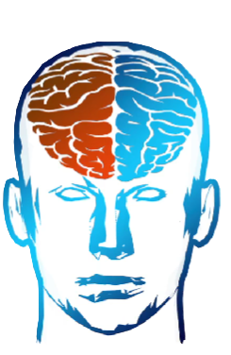
UNDERSTANDING NATURAL MOTOR MOTIONS
AND COGNITIVES PREFERENCES
emphasize the physical capacities and natural qualities of an athlete (called motor profile) and to limit training that is far from the athlete's spontaneous qualities (called opposite motor profile or shadow zone) in order to limit the risks of regressing by inhibiting the athlete's natural qualities, which would result in a loss of self-confidence and an increased risk of injury.
Motor preferences encompass the unique characteristics that affect how players execute movements in tennis, influencing their performance.
A preference is something that anagrammed in me that I know to do naturally Cross arms, fingers ,legs and they come from the Nervous System and how it face the Gravity it’s what why the Balance is very important :

Slide 4
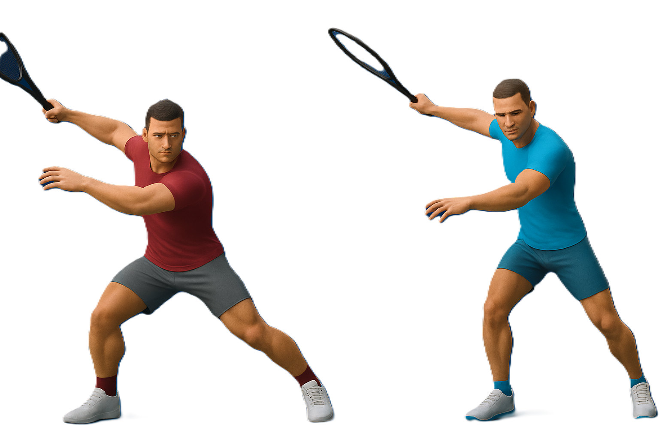
We can start by observing the player as they are how they are moving naturally (ecologic mode) and find their natural skills and motricity;
From there let’s coach then using EBP evidence base practice
1/3OF SCIENCE (biomechanics/ kinetic chain data )
1/3 OF STAFF EXPERIENCE (coach, fitness trainer, mental coach, parents)
1/3 OF PLAYER FEEDBACK (emotion, performance…)
Using the approach players will move efficiency, not only efficacy
Difference between these too word is HUGE

Slide 5
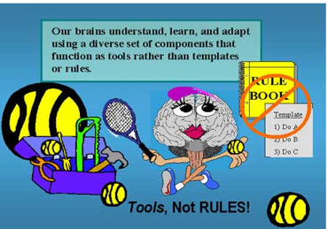
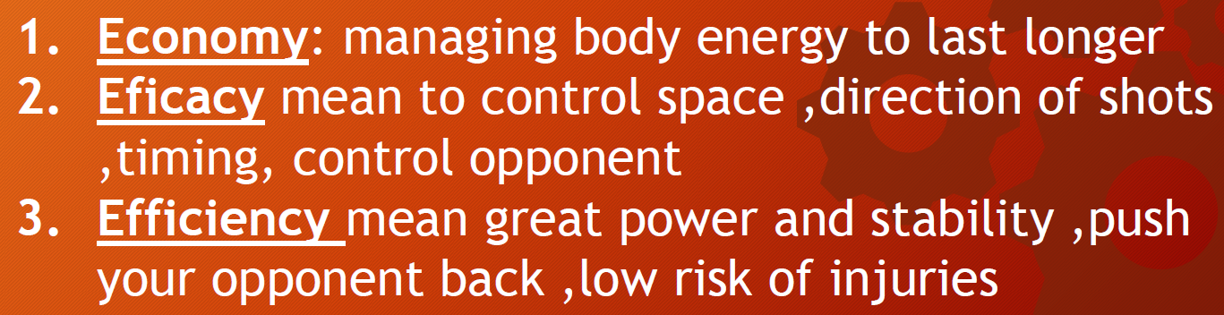
The power of individualisation coaching
NATURAL MOTORS MOTIONS
PREFERENCES ARE ACCELARATOR OF
MOTOR LEARNING

Slide 6
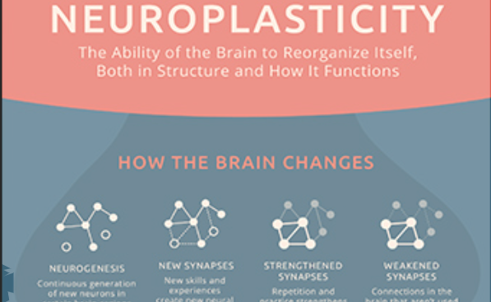
3 pillars
REGULARITY
INTENSITY
PROGRESS
EVERYDAY THE BRAIN PRODUCE 700 NEW NEURONS IN THE HIPPOCAMPUS( MEMORY AND LEARNING )
IT TAKE AROUND 66 DAYS TO AUTOMTATE A NEW BEHAVIOR OF EVERYDAY REPETITION+ SELF PRACTICE

Slide 7
REGULARITY / CONSISTENCY
THE BRAIN LIKE REGULARITY
NOW IS IT BETTER TO TRAIN 2 TIME A WEEK 2 HOURS PER SESSIONS ?
OR
IS IT BETTER TO TRAIN ONLY 30 MNS EVERYDAYS FOR 6 DAYS ?
THE REGULARITY IS BETTER + SELF PRACTICE

Slide 8
MONITORING PROGRESS
The power of measure
FEELING OF PROGRESS IS A VERY STRONG FACTOR
More powerful than money
More powerful the recognition
More addictive than success
You can choose 5 criteria to measure your progress every week
Reaction speed
Footwork precision
Shots precision
Mental routine
Mental calm

Slide 9
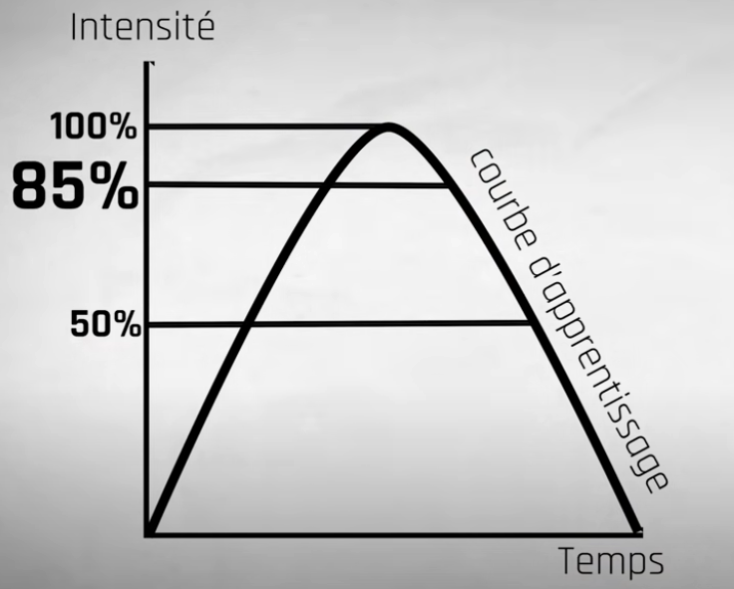
INTENSITY
LEARNING CURVE
TIME

Slide 10

DRILL LEARNING PROCESS
TOO HARD / PANIC
8.5 TO 10
ZONE IMAGINATION / DREAM TO DO
STRECHT ZONE
ADD 4% OF WORK LOAD
PER WEEK
85 % OPTIMAL ZONE OF LEARNING = DOPAMINE RELEASE
5 TO 7
LEARNING ZONE
WHAT I THINK I CAN DO
0 TO 5
TOO EASY / CONFORT ZONE
WHAT I KNOW TO DO

Slide 11
DO YOU REALLY UNDERSTAND WHO IS THE PLAYER IN FRONT OF YOU ?
HOW CAN YOU YOUR PLAYERS TO IMPROVE QUICKLY AND IN A EASIER WAY ?

Slide 12
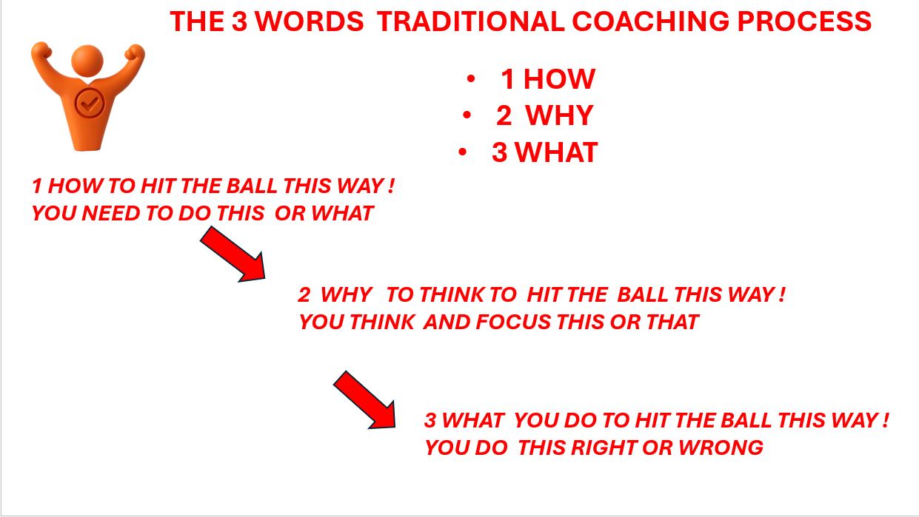
Coach say
Coach say
Coach say

Slide 13
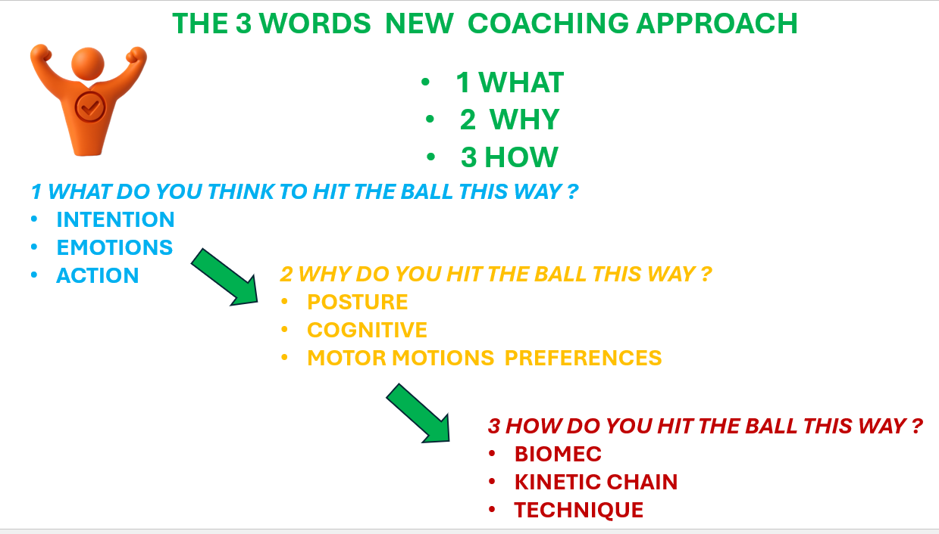
Coach ask
Coach ask
Coach ask

Slide 14
IS THERE A MISSING LINK THAT MAKE MY PLAYERS TO STILL NOT LEARNING THE WAY I TEACH THEM ?
OR STRUGGLE TO PERFORM BETTER ?
OR SOMETHING I DON’T KNOW ?
OR
TO LEARN THE SAME MOVEMENT, I TEACH THEM FOR LONG TIME ?

Slide 15

Learning preferences how the best performers learn differently
SETTING INTENTION
BEFORE ANY EXPERINCE( training, drills ,exercises ,match)
Ask “WHAT I WANT TO LEARN ?
Or WHAT SKILL I’M focus ON BUILDING ?
This question sets a mental filter (ASR-Google)making
relevant information stand out , you program your brain
To notice all relevant info what matter most.

Slide 16
REFLEXION
Post experience reflection turns thoughts into long lasting lessons.
Its not just passive learning
It’s an active learning process
WHAT DID I LEARN ?
HOW CAN THIS APPLY TO THE FUTUR? WHY DID THAT HAPPEN ?
research show that few minutes reflective
at the end of the day/session
Can have a huge impact on learning and performance
Around 20 % better result

Slide 17
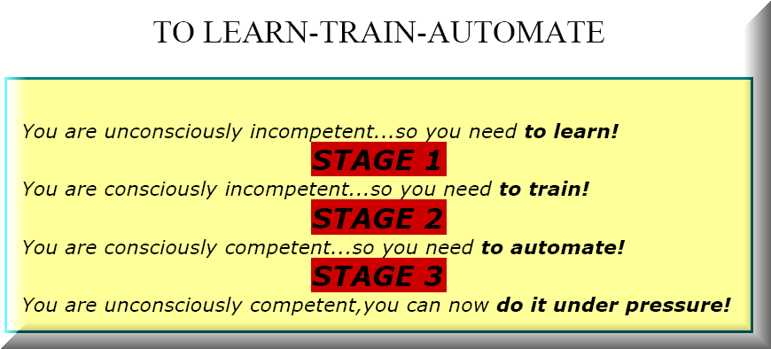

Slide 18

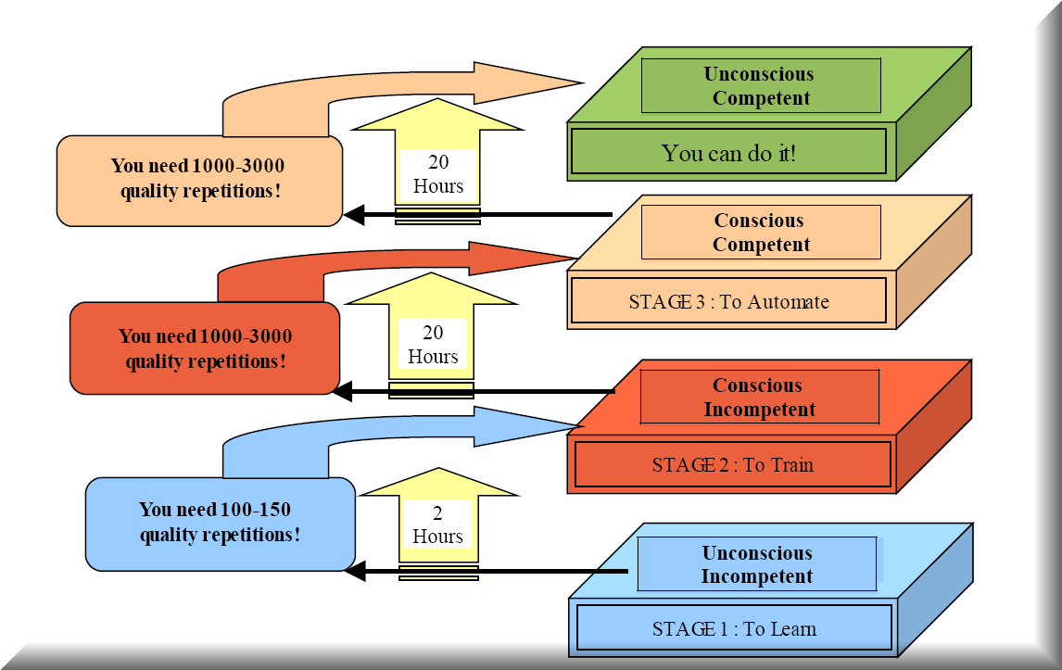

Slide 19
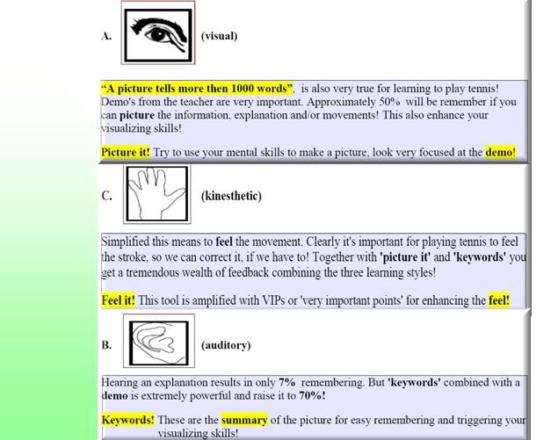
LEARNING
CHANNELS
PREFERENCES

Slide 20
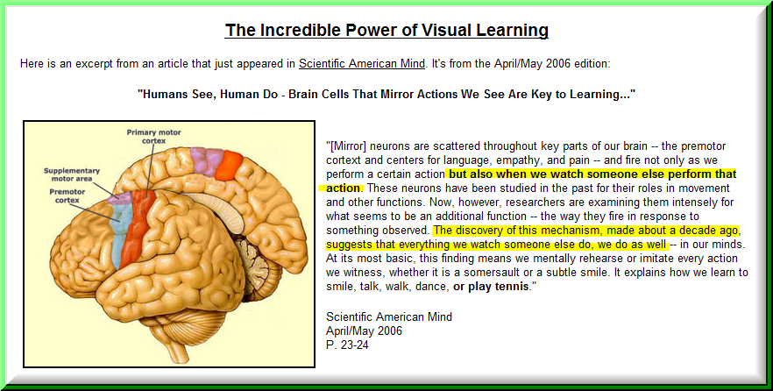

Slide 21
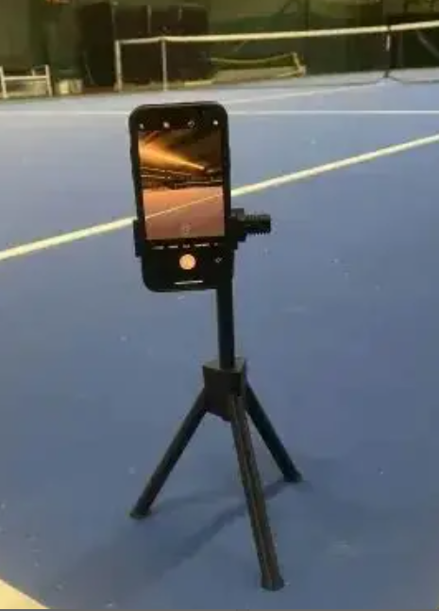
THE 4 STEPS ON THE COURT VISUALISATION TRAINING
3 REPETITIONS FOR EACH STEP USING
THE RIGHT INTENTION-EMOTION-ACTION
STEP 1 - WATCH A VIDEO
NORMAL / SLOW MOTION SPEED OF THE ELEMEBT TO WORK ON
STEP? 2 – ASSOCIATE VISUALSATION
CLOSE YOUR EYES AND VISUALISE INTERNALY YOURSELF DOING THE MOTION
FEELING THE MOTIONS AND SPEED OF THE MOTION
STEP 3 – DISSOCIATED VISUALISATION
CLOSED OR OPEN YOUR EYES VISUALIZE YOURSELF IN FRONT OF YOU DOING THE MOTION
STEP 4 – HIIT THE BALL WITH THE RIGHT INTENTION –ACTION
THEN REPETE THE CIRCLE

Slide 22
EXPERIMENTATION
Is that human learn bast when they are given
The opportunity to Experiment and Explore an Idea
In the absence of micro-management
or rot repetition
Also, this promotes individual imitative
which will become
Very significant during a match.

Slide 23

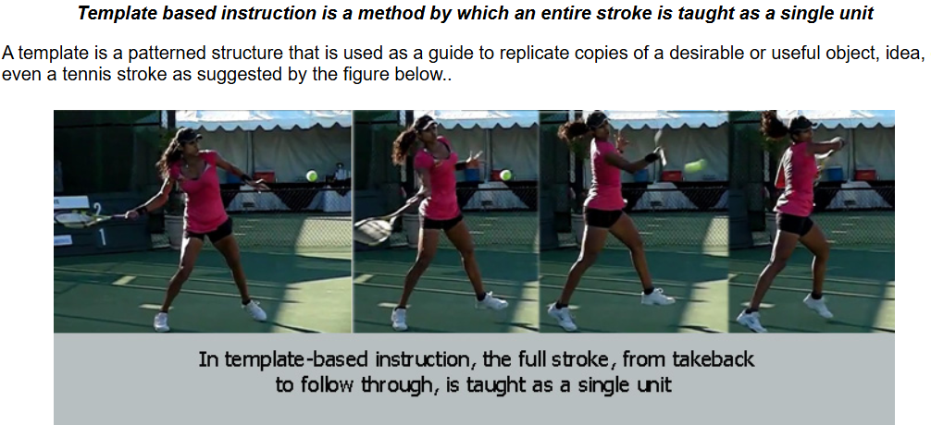
COMPONENTS BASED LEARNING
IS THAT A SKILL IS BEST BROKEN DOWN
INTO SAMPLE UNITS THAT CAN BE EASILY
CONSUMED AND RETAIN BY THE BRAIN
AND RESUSED IN A VARIETY OF CONTEXTS

Slide 24
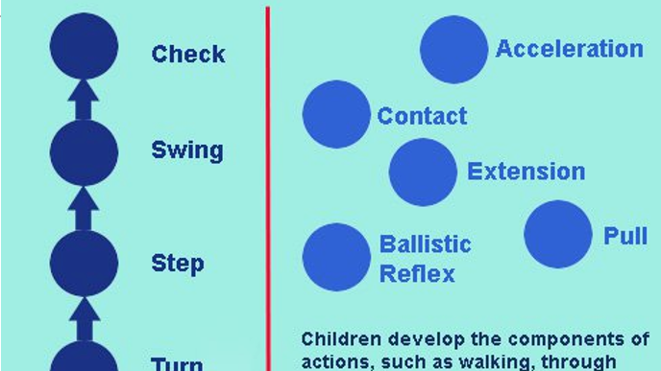

Slide 25
We learn by positive reinforcement
Its very powerful so
We can reinforce
e their natural motors motions
To improve and get better player.
TELL THEM WHAT THEY GOOD AT !!!
0,3 % OF IMPROVEMENT EVERYDAY = 100% 1 year

Slide 26
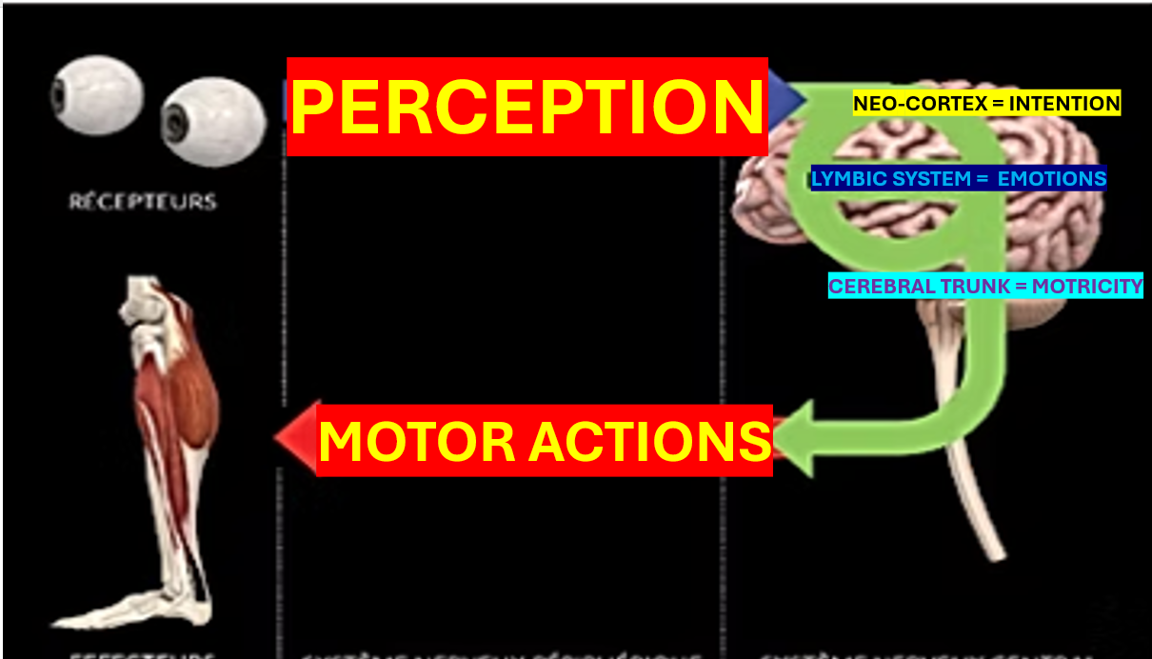

Slide 27
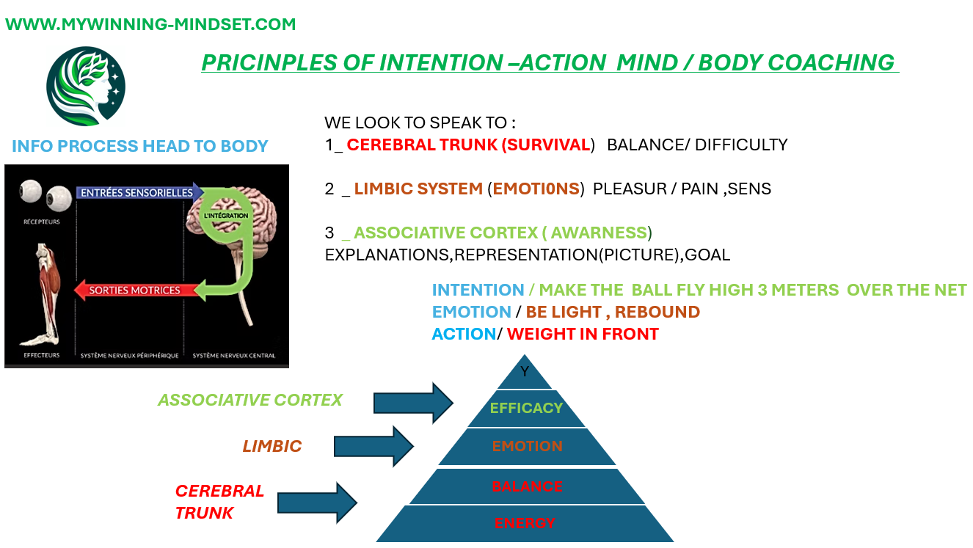

Slide 28
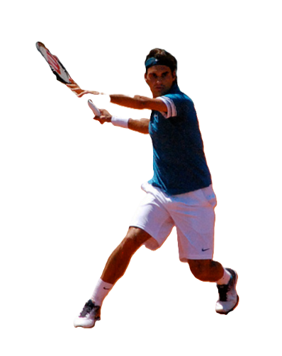
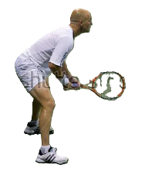
MATCHING PROFILE TYPES OF EXCERCICES
AERIAL TYPE
GROUNDED TYPE
1- ELONGATION
2- STIFFNESS
3 -REACTIVITY
4- PROJECTION
1 – MOBILITY
2- STABILITY
3- STRENGHT
4 - PROPULSION

Slide 29
COACHING QUESTIONS TO HELP MOTOR LEARNING
Clarification
What do you mean by what?
QUESTIONS
HELP PLAYERS TO BECOME BETTER AT :
DECISION MAKING
SOLVING PROBLEMS
REFLECTIVE LEARNER
Probing assumptions
What are you assuming will happen ?
Exploring perspectives
How would your opponent see that point ?
Implications
What will happen if you lost this point ?
Probing reasons
Why did you make that decision ?
Meta-quetions
What did this question help you realise?

Slide 30
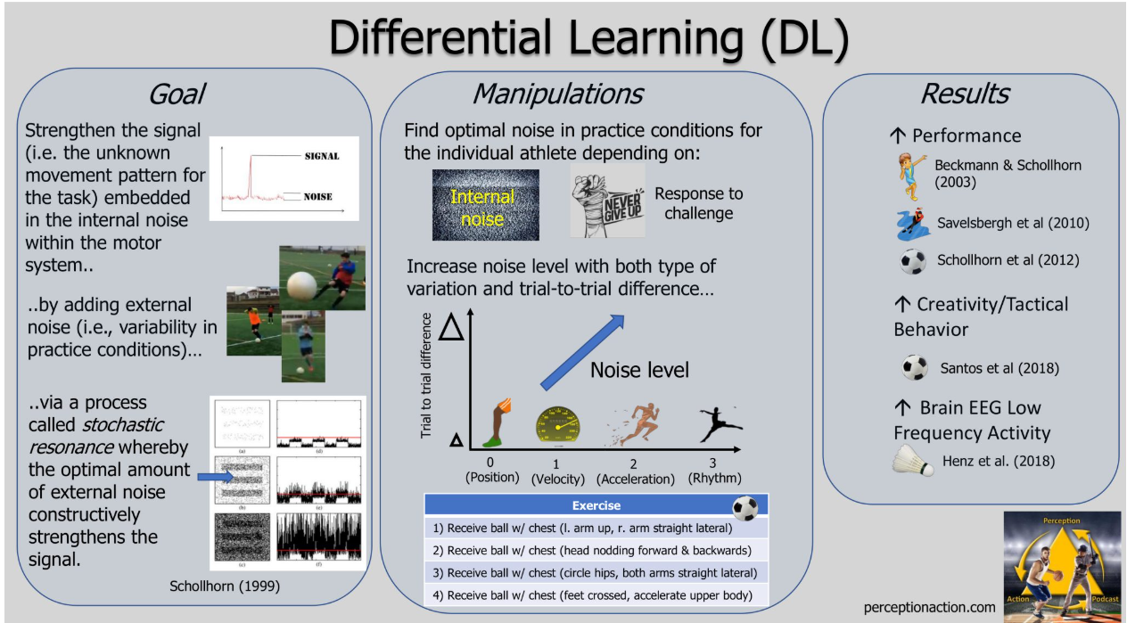
DIFFERENTIAL LEARNING CHALLENGES CONVENTIONAL COACHING
BY REJECTING THE NOTION OF A “CORRECT WAY” TO PERFORM A SKILL.
INSTEAD,IT EMBRACE “VARIABILITY” AND ENCOURAGE PLAYERS TO ADAPT TO DIFFERENTS CONDITIONS

Slide 31
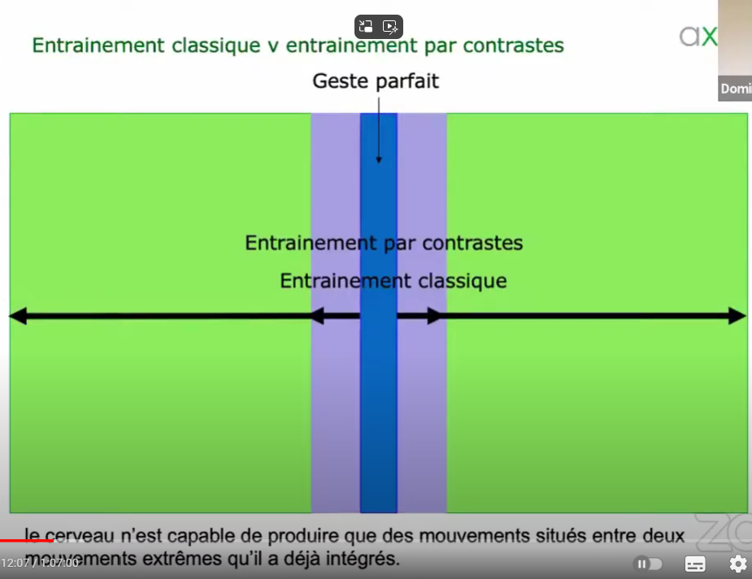
DIFFERENTIAL LEARNING
PERFECT MOTION
REPETITION WITHOUIT REPETITION OF THE SAME MOTION
CONSTRAINT TRAINING
CLASSIC TRAINING
WE CAN’T REPETE THE
EXACT SAME MOTION
VARIABILITY IN TRAINING BRING
STABILITY IN COMPETITION
THE BRAIN IS ABLE TO PRODUCE ONLY MOVEMENTS SITUATED BETWEEN 2 EXTREMES MOVEMENTS THAT ARE ALREADY INTEGRATED

Slide 32
VARIABILITY
1 Define rules
give a precise thing to do
hit a target
No task how to do it
No judgement
Finish with Normal shots to verified
how things become easier

Slide 33
VARIABILITY
2 ON THE PLAYER
In his position
Toward the incoming ball, close, far , mid way with an angle, on 1 foot )
IN MOVEMENT (walking, balancing, bouncing, or in static
Moving laterally, backward, foreword.
Grip/ HAND POSITION, ( 1 hand, mid grips, strings hand )
Modified stroke , bigger , shorter, higher ,lower takeback )

Slide 34
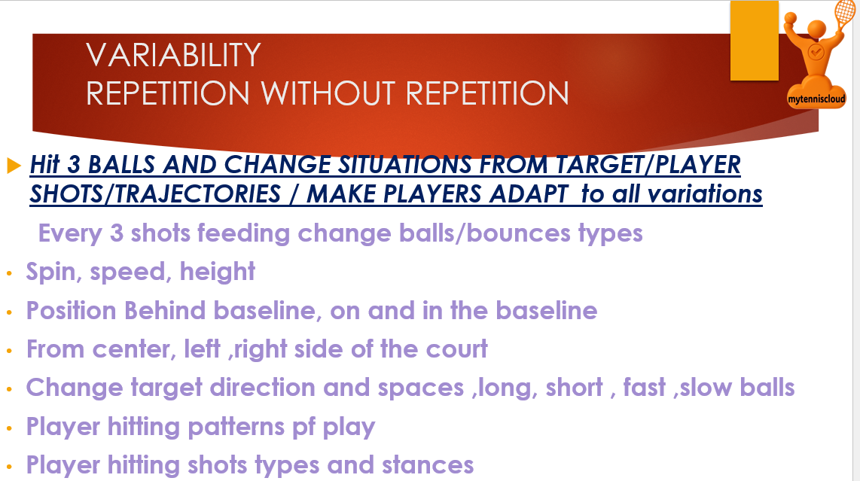

Slide 35
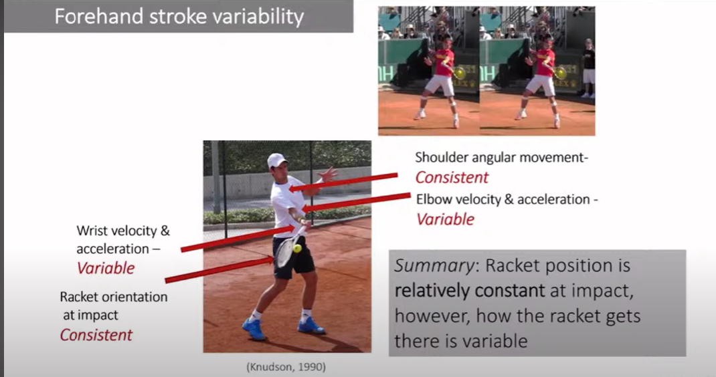

Slide 36
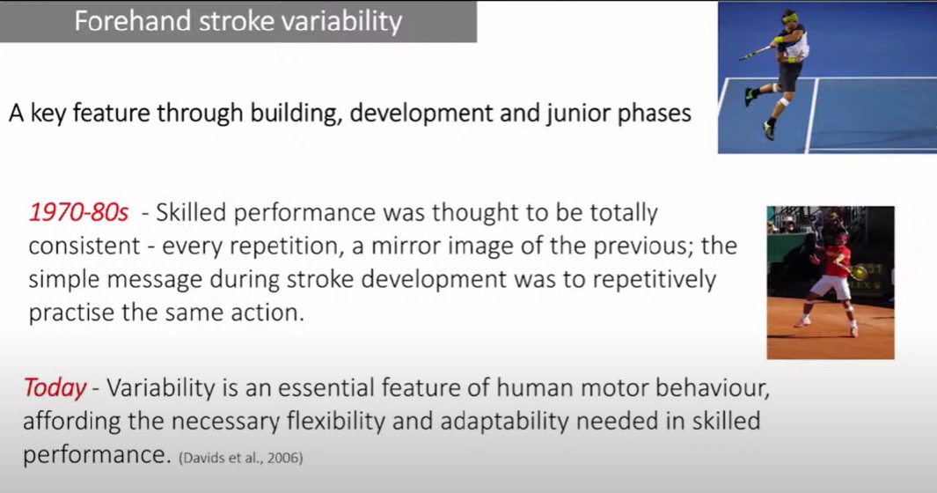

Slide 37
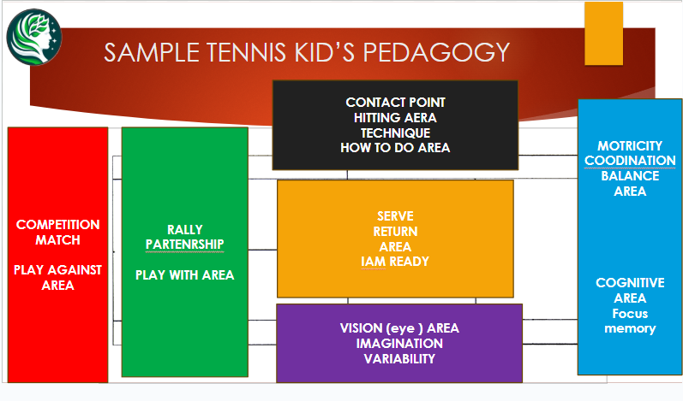
MINI TENNIS SAMPLE LEARNING AERAS

Slide 38
THANK YOU AND QUESTION TIME

